Slide 1
Unit-1 & Unit- 2 Fundamentals of IoT IoT Access Technologies
Dr. Madhukrishna Priyadarsini
Department of CSE

Slide 2
Outline
Evolution of IoT
IoT Architecture and Design
Smart Objects: The “Things” in IoT
Connecting Smart objects

Slide 3
Evolution of IoT
What is IoT?
Why IoT is required?
History of IoT
Examples
Convergence of IT and OT
IoT Challenges

Slide 4
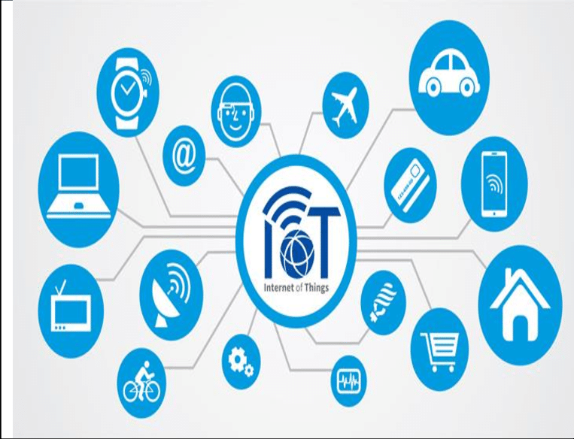
Chapter 1: What is IoT?
Goal is to “Connect the Unconnected”.
The interconnection via the Internet of computing devices embedded in everyday objects, enabling them to send and receive data.

Slide 5
Contd…
Internet technology connecting devices, machines, and tools to the Internet by means of wireless technologies.
“Things” connected to the Internet are projected to cross 50 billion in the near future.
Unification of technologies such as low-power embedded systems, cloud computing, big data, machine learning, and networking.

Slide 6
Why IoT is required?
More data -> better decision
Ability to track and monitor things
Lighten the workload with automation
Increases efficiency by saving money and resources
Better quality of life

Slide 7
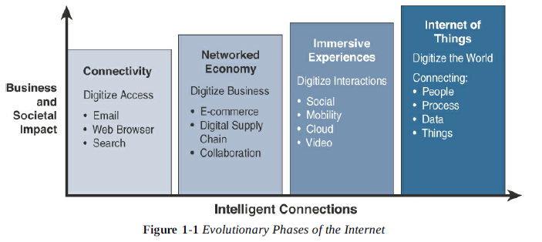
History of IoT

Slide 8
Characteristics of IoT
Connectivity
Intelligence and Identity
Scalability
Dynamic and Self-adapting
Architecture
Safety

Slide 9
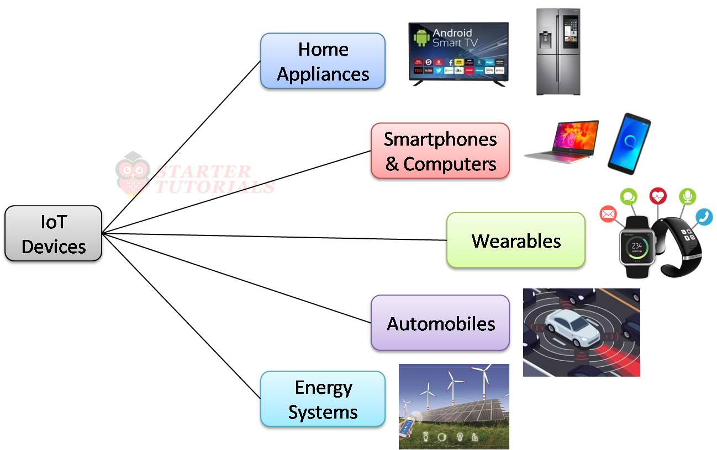
Examples
More things:
Pacemakers
Biochip-transponders
Automobiles with built-in sensors
Food quality measuring
So “Things”== hardware+ software+ data+ services!!

Slide 10
Retail Environment IoT Devices?
Facility management
Traffic control
Buyer behaviour tracking
Supply chain logistics
Cold chain monitoring
Asset tracking
Personalized shopping
Smart shelves

Slide 11
Convergence of IT and OT
Criteria | Industrial OT Network | Enterprise IT Network
Operational focus | Keep the business operating 24*7 | Manage the data, computers, and employee communication system in a secure way
Priorities | Availability, integrity, security | Availability, integrity, security
Types of data | Monitoring, control and supervising data | Voice, video, bulk data
Security | Controlled physical access to devices | Devices and users authenticated to the network
Implication of failure | OT network disruption directly impacts business | Can be business impacting depending on industry
Network upgradation | Only during operational maintenance | Often requires when workers are not onsite
Security vulnerability | Low | High

Slide 12
Challenges in IoT
Scalability
Security
Privacy
Data Analytics
Interoperability

Slide 13
Chapter 2: IoT Network Architecture and Design
Drivers behind new network architectures
Comparing IoT architectures
A simplified IoT architecture
The core IoT functional stack
IoT data management and compute stack

Slide 14
Drivers behind new network architectures
Challenge | Description | IoT architectural change required
Scale | Massive scale of sensors beyond typical IT networks | Introduction of IPv6 or IPv4 using NAT
Security | IoT devices use WSN are exposed | Every end-point device need device-level authentication and link encryption
Devices and networks constrained by power, CPU, memory, link speed | Due to massive scale and longer distance the network supports minimal data rates | Last-mile wireless technologies are needed for long distances. Modification need to traditional network layer
The massive volume of data generated | Sensors generated massive data causing network bottlenecks and slow analytics in the cloud | Data analytics capabilities need to be distributed throughout the IoT network, from the edge to the cloud
Support for legacy devices | Collection of Ip-capable end points as well as legacy, non-IP devices that rely on proprietary protocols | IoT networks need to support protocol translation or tunnelling mechanism to support legacy protocols
The need for data to be analyzed in real time | IoT data needs to be analyzed and responded in real time | Should support real time streaming analytics

Slide 15
Comparing IoT Architectures
The oneM2M IoT standardized architecture
The IoT World Forum (IoTWF)

Slide 16
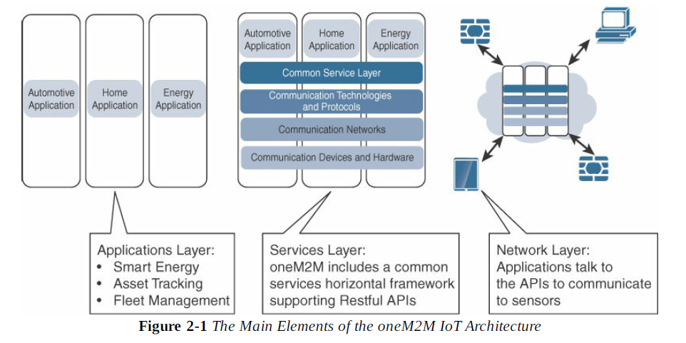
The oneM2M Architecture

Slide 17
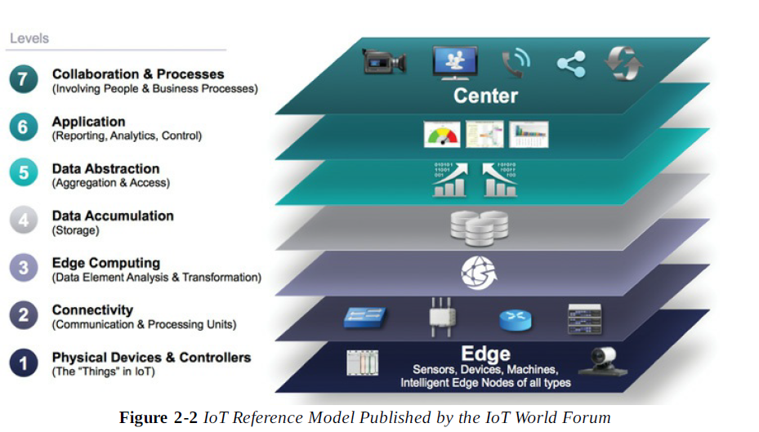
The IoT World Forum (IoTWF)

Slide 18
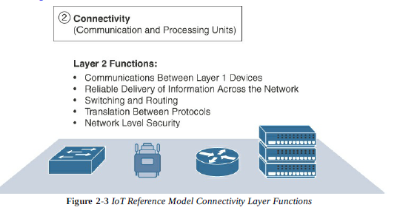
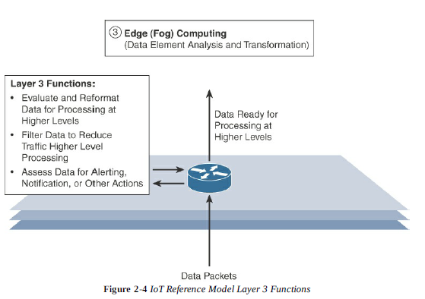
Contd…

Slide 19
Contd…
IoT Reference Model Layer | Functions
Layer 4: Data accumulation layer | Captures data and stores it so that it is usable by applications when necessary. Converts event-based data to query based processing.
Layer 5: Data abstraction layer | Reconciles multiple data formats and ensures consistent semantics from various sources. Confirms that the data set is complete and consolidates data into one place or multiple data stores using virtualization.
Layer 6: Application layer | Interprets data using s/w applications. Applications may monitor, control, and provide reports based on the analysis of the data.
Layer 7: Collaboration and process layer | Consumes and shares the application information. Collaborating on and communicating IoT information often requires multiple steps, and it is what makes IoT useful. This layer can change business process and delivers the benefits of IoT.

Slide 20
Benefits of IoTWF Model
Decompose the IoT problem into smaller parts.
Identify different technologies at each layer and how they relate to one another
Define a system in which different parts can be provided by different vendors.
Have a process of defining interfaces that leads to interoperability.
Define a tiered security model that is enforced at the transition points between levels.

Slide 21
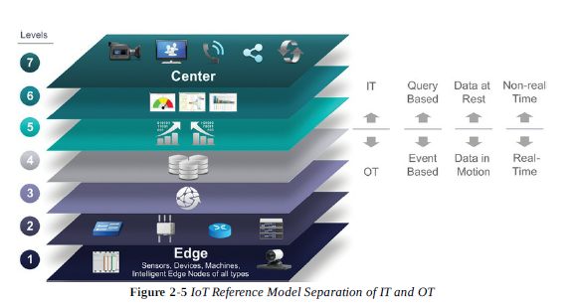
IT and OT Responsibilities in the IoT Reference Model

Slide 22
Additional IoT Reference Models
IoT Reference Model | Description
Purdue model of control hierarchy | It segments devices and equipment into hierarchical levels and functions. It is used as a base for many IoT-related models and standards across industry.
Industrial Internet Reference Architecture (IIRA) by industrial internet consortium | It is a standards-based open architecture for Industrial Internet Systems (IIS). It distills and abstracts common characteristics, features, and patterns from use cases well understood at this time, predominantly those that have been defined in the IIC.
Internet of Things Architecture (IoT-A) | It is defined as an initial set of key building blocks that are foundational in fostering the emerging IoT. Using an experimental paradigm, IoT-A combined top-down reasoning about architectural principles and design guidelines with simulation and prototyping in exploring the technical consequences of architectural design choices.

Slide 23
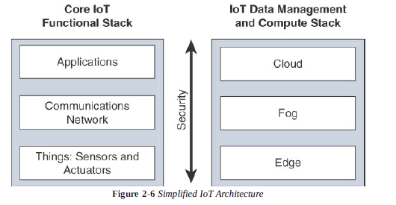
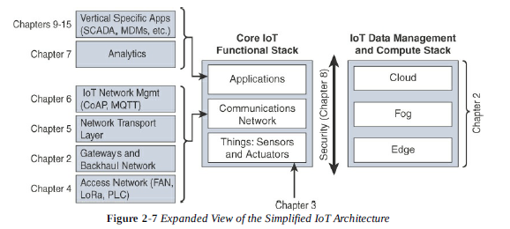
A Simplified IoT Architecture

Slide 24
The Core IoT Functional Stack
“Things layer”-> Physical devices need to fit the constraints of the environment
Communication network layer-> When smart objects are not self-contained, they need to communicate with external systems
Access network sublayer: uses wireless technologies such as 802.11ah, 802.15.4g, LoRa
Gateways and backhaul network sublayer: forward the collected information through a longer-range medium (backhaul)
Network transport sublayer: for successful communication network layer and transport layer protocols must be implemented to support variety of devices
IoT network management sublayer: Additional protocols to allow headend applications to exchange data with sensors
Application and analytics layer-> processing of collected data in order to make intelligent decision based on the information collected to adapt to the change in parameter

Slide 25
Layer 1:Things: Sensors and Actuators layer
Architectural classification of “Things”(smart objects):
Power-connected
Mobile or static
Low or high reporting frequency
Simple or rich data
Report range
Object density per cell

Slide 26
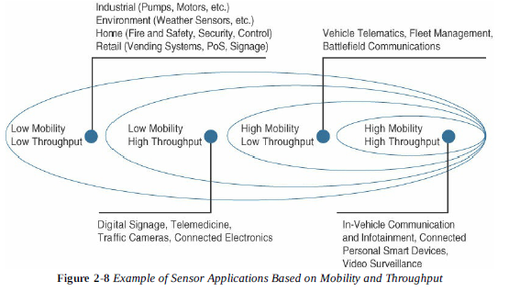
Example:

Slide 27
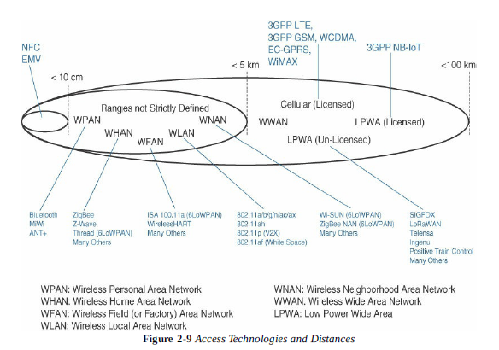
Layer 2: Communication Network Layer
Access network sub layer:

Slide 28
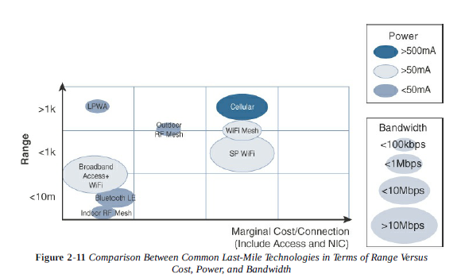
Contd…
Factors: range, throughput, cost
Point-to-point topologies
Point-to-multipoint topologies

Slide 29
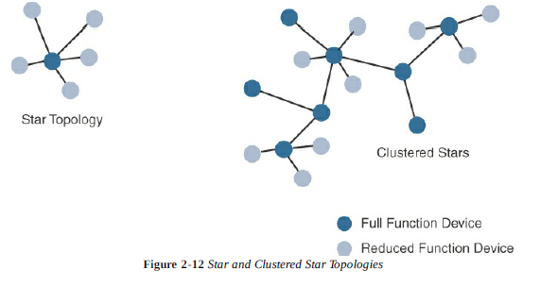
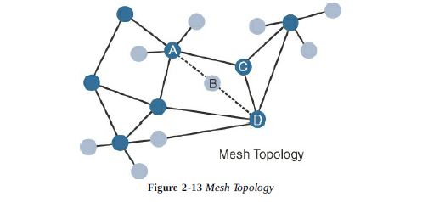
Contd…
RFD(Reduced-function device)
FFD(Full-function device)-> multiple peer-to-peer connection

Slide 30
Gateways and Backhaul Sublayer
WiMAX(802.16)->50-70km, 70mbps
Architectural Considerations for WiMAX and Cellular Technologies
Technology | Type and Range | Architectural Characteristics
Ethernet | Wired, 100m max | Cable/sensor, link is reliable
Wi-Fi(2.4GHz, 5GHz) | Wireless, 100m to few kms | Multiple clients to a single AP, large bandwidth available
802.11ah(wi-fi in sub-1 GHz) | Wireless, 1.5km(multipoint) ,10km(point-to-point) | Large number of clients, power efficient, limited bandwidth, low adaption
WiMAX(802.16) | Wireless, several kms(last mile), 50km(backhaul) | Large number of clients, large bandwidth in licensed spectrum, reduced bandwidth in license-free spectrum, adaption varies on location
Cellular(LTE) | Wireless, several kms | Large number of clients, large bandwidth in licensed spectrum

Slide 31
Network Transport Sublayer
Peer-to-peer, point-to-point, point-to-multipoint, unicast, multicast communication
Scalability, openness, security are major requirements
IP, TCP, UDP, TLS/SSL are the protocols
Example: distribution automation(DA), smart meter, smart system

Slide 32
IoT Network Management Sublayer
Push model-> sensor reports at a regular interval based on trigger
Pull model->application queries the sensor over the network
Protocols used:
HTTP
MQTT(Message Queue Telemetry Transport)
XMPP(Extensible Messaging Presence protocol)
CoAP(Constrained Application protocol)

Slide 33
Layer-3: Applications and Analytics Layer
Analytics versus Control applications
Analytics->collect data, process it, displays the processed information(historic reports, statistics, individual system state), conveys a view of the network
Control application->controls behaviour of the smart object(ex:SCADA: remote sensor) or the object related to smart object
Data versus Network Analytics
Data Analytics->process data and provides an intelligent view(ex: storm prediction)
Network Analytics->complete system is analyzed
Data Analytics versus Business benefits(ex: Cisco Jasper->turnkey cloud based platform)
Smart services-> the ability to use IoT to improve operations(efficiency, safety, co-ordination)

Slide 34
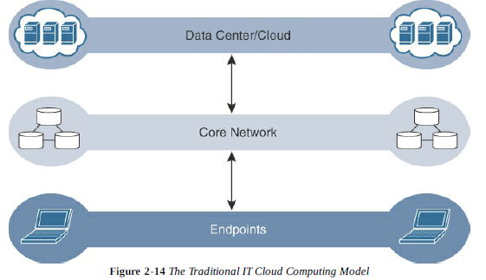
IoT Data Management and Compute Stack
Minimizing latency
Conserving network bandwidth
Increasing local efficiency

Slide 35
Contd:
Data-related Problems need to be addressed in IoT environment:
Bandwidth is limited
Network backhaul is unreliable
Latency is high
Data volume is huge
Analyzing and storing sensor data (big data) is impractical

Slide 36
Fog (rests near the ground)Computing
Any device with computing, storage, and network connectivity can be a fog node.
Functions: data reduction, monitoring and analyzing real-time data, initiating an action
Characteristics of Fog Computing:
Contextual location awareness and low latency-> close to IoT endpoints to deliver distributed computing
Geographical distribution-> distributed deployments
Deployment near IoT endpoints-> 3000 to 4000 nodes/gateway
Wireless communication between the Fog and IoT endpoints->wireless access is easiest
Use for real-time interactions-> pre-processing of data allows upper layer applications

Slide 37
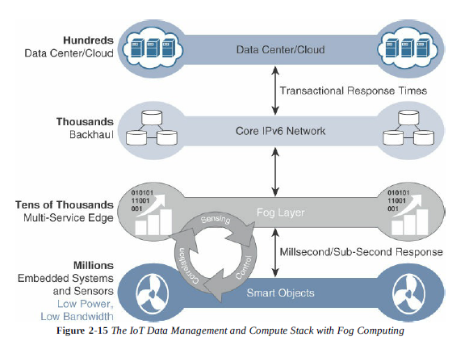
Contd…

Slide 38
Edge(Mist) Computing
Actual IoT end point devices
Ex: electrical distribution grids

Slide 39
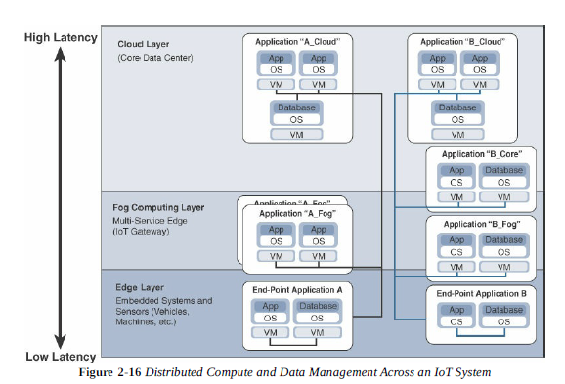
Hierarchy of Edge, Fog, and Cloud Computing

Slide 40
Contd…
The most time-sensitive data is analyzed on the edge/fog closest to the “things” generating data.
Data that can wait seconds/minutes for action is passed along to an aggregation node for analysis and action.
Data that are less time-sensitive are sent to the cloud for historical analysis, big-data analytics, and long-term storage.

Slide 41
Chapter 3: Smart Objects: The “Things” in IoT
Smart objects are any physical objects that contain embedded technology to sense and/or interact with their environment in a meaningful way by being interconnected and enabling communication among themselves.
Sensors, Actuators, and smart objects
Sensor Networks

Slide 42
Sensors:
A sensor measures some physical quantity and converts that measurement reading into a digital representation.
The digital representation is passed to another device for transformation into useful data that can be consumed by intelligent devices or humans.
Sensor categories:
Active or passive (energy output and external power supply)
Invasive or non-invasive (part of the environment it is measuring or external)
Contact or no-contact (physical contact for measurement or not)
Absolute or relative (measure on absolute scale or uses reference value)
Area of application (based on specific industry where they are used)
How sensors measure (physical mechanism used to measure)
What sensors measure (physical variables measure)

Slide 43
Sensor types
Sensor types | Description | Examples
Position | Measures position of an object; can be linear angular, multi-axis | Potentiometer, inclinometer, proximity sensor
Occupancy and motion | Occupancy sensor detects the presence of living objects in surveillance area, motion sensor detects movement of the living objects | Electric eye, radar
Velocity and acceleration | Velocity sensor measures how fast an object moves along a straight line or how fast it rotates. Acceleration sensor measures changes in velocity | Accelerometer, gyroscope
Force | Detects whether a physical force is applied and whether the magnitude of force is beyond the threshold | Force gauge, viscometer, tactile sensor
Pressure | Measures force applied by liquid gases | Barometer, piezometer
Flow | Detects rate of fluid flow | Water meter, mass flow sensor

Slide 44
Sensor types
Sensor types | Description | Examples
Acoustic | Measures sound levels and converts that information into digital or analog data signals | Microphone, hydrophone
Humidity | Detects humidity in the air or mass | Soil moisture sensor, hygrometer
Light | Detects the presence of light | Infrared sensor, photo detector
Radiation | Detects radiation in the environment | Neutron detector
Temperature | Detects the amount of heat or cold present in a system (contact or non-contact) | Thermometer, calorimeter
Chemical | Measures the concentration of chemicals in a system | Breathlyzer, smoke detector
Biosensors | Detects several biological elements (tissue, cell, enzymes, antibodies, nucleic acid) | Blood glucose, pulse, electro-cardiogarph

Slide 45
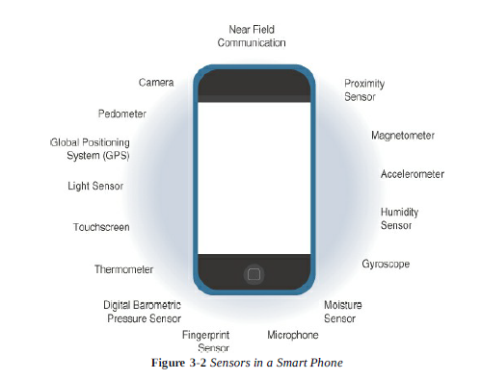
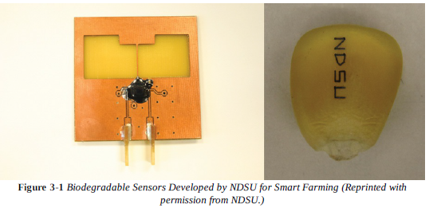
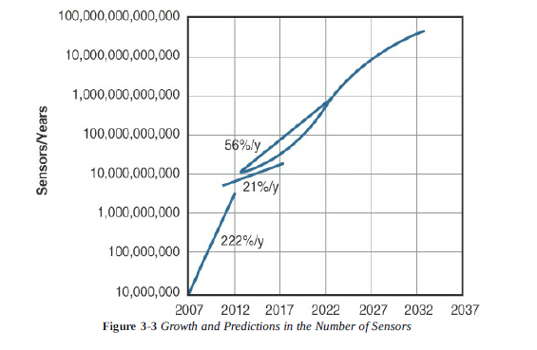
Examples:

Slide 46
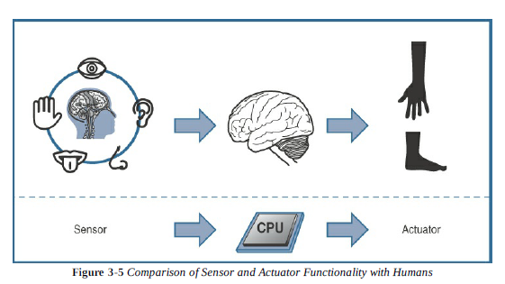
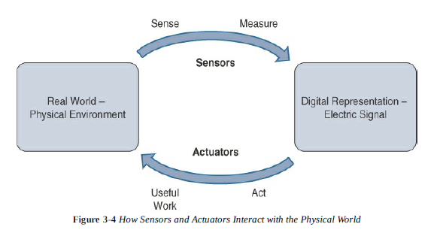
Actuators: (Natural complements to sensors)
Receive some types of control signal (commonly an electric signal or digital command) that triggers a physical effect, usually some type of motion, force and so on.

Slide 47
Categories of Actuators:
Type of motion (linear, rotary, axes)
Power (power output)
Binary or continuous (number of stable state output)
Area of application (specific industry or vertical where they are used)
Type of energy (energy type utilized)

Slide 48
Actuator Classification based on energy type
Type | Examples
Mechanical actuators | Lever, screw jack, and hard crank
Electrical actuators | Thyristor, bipolar transistor, diode
Electromechanical actuators | AC motor, DC motor, step motor
Electromagnetic actuators | Electromagnet, linear solenoid
Hydraulic and pneumatic actuators | Hydraulic cylinder, pneumatic cylinder, piston, pressure control valves, ait=r motors
Smart material actuators (includes thermal and magnetic actuators) | Shape memory alloy, ion exchange fluid, bimetallic strip
Micro and nano actuators | Electrostatic motor, microvalve, comb drive

Slide 49
Smart Objects:
Smart objects transfer everyday object into a network of intelligent objects that are able to learn from and interact with their environment in a meaningful way.
A smart object is a device which has minimum four characteristics as follows:
Processing unit
Sensors and/or actuators
Communication device
Power source (electric power, battery power, scavenger sources)

Slide 50
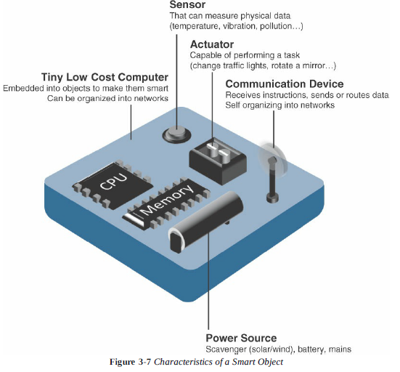

Slide 51
Trends in smart objects:
Size is decreasing
Power consumption is decreasing
Processing power is increasing
Communication capabilities are improving
Communication is being increasingly standardized
These trends create sophisticated devices that are able to perform increasingly complex tasks with greater efficiency.

Slide 52
Sensor Networks:
SANETs in the real world need an extreme level of deployment flexibility.
Advantages of wireless-based solution:
Greater deployment flexibility
Simpler scaling to a large number of nodes
Lower implementation cost
Easier long-term maintenance
Effortless introduction of new sensor/actuator nodes
Better equipped to handle dynamic topology changes
Disadvantages of wireless-based solution:
Potentially less secure
Typically lower transmission speed
Greater level of impact by environment
Wireless SANETs are typically referred as wireless sensor networks (WSNs), considering actuators are part of WSNs

Slide 53
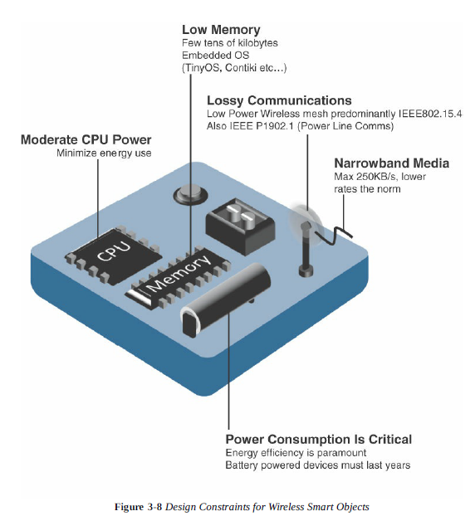
Wireless Sensor networks (WSNs)
WSN is created using the wirelessly connected smart objects known as motes.
Limitations of smart objects in WSNs
Limited processing power
Limited memory
Lossy communication
Limited transmission speeds
Limited power
Smart objects with limited processing, memory, power are often referred as Constrained nodes

Slide 54
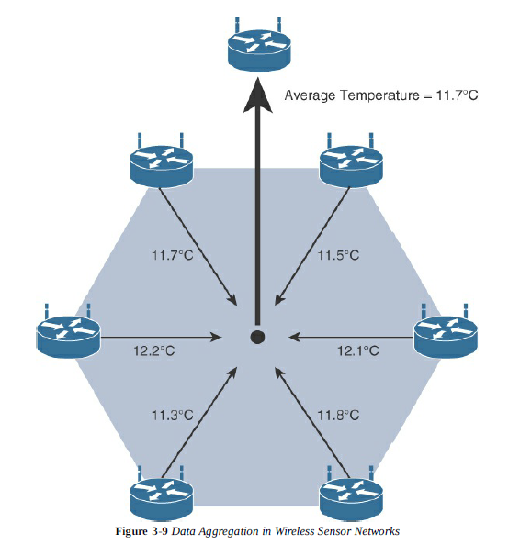
Contd…
Communication patterns:
Event-driven
Periodic
Example:
Mission critical applications considering
Automation techniques such as self-
optimization, self-protection, self-healing
-> Communication Protocols (considers
Power consumption, transmission speed,
Range, tolerance of packet loss, topology
Optimization, security)

Slide 55
Chapter 4: Connecting Smart Objects
Communication criteria:
Ranges: signal propagation and distance
Frequency bands: licensed and unlicensed spectrum
Power consumption: stable power source or battery power source
Topology: Layouts
Constrained devices: limitations of objects
Constrained-Node networks: challenges during connection
IoT Access Technologies:
IEEE 802.15.4: foundational wireless protocol
IEEE 802.15.4g and IEEE 802.15.4e: improvements to 802.15.4 for smart city deployments
IEEE 1901.2a: connection over power lines
IEEE 802.11ah: Wi-Fi for smart objects
LoRaWAN: long distance communication with low power requirements in the unlicensed spectrum
NB-IoT and other LTE variations: long distance communication in licensed spectrum used by mobile service providers

Slide 56
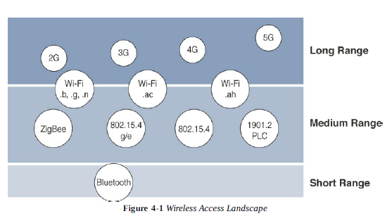
Communication Criteria
Range:

Slide 57
Frequency bands:
Licensed bands (long range access technologies, communication service providers, public services, broadcasters)
Unlicensed bands (industrial, scientific, medical applications): no guarantees for security, ex: wi-fi, WPAN, Bluetooth
Power Consumption:
Powered nodes
Battery-powered nodes (LPWA-low power wide area)

Slide 58
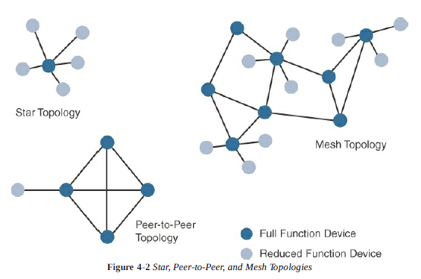
Topology:
Star, mesh, and peer-to-peer
Long range, short range-> star
Medium range-> star, peer-to-peer, mesh
Ex: indoor wi-fi->star, outdoor wi-fi->mesh
Mesh topology protocol->mesh-under or
mesh-over

Slide 59
Constrained devices: Limited resources that impact their networking feature set and capabilities
Classification of constrained nodes
Class | Definition
Class 0 | Severely constrained with less than 10KB of memory, less than 100KB of processing and storage capability. Typically battery powered. Do not have resources to implement IP stack and security mechanisms. Ex: unlicensed LPWA wireless technology
Class 1 | Approximately 10KB RAM, 100KB processing and storage capability. Not suitable to implement IP stack. This is suitable for implementing an optimized stack for constrained nodes, such as Constrained Application Protocol (CoAP). Without gateway these nodes can communicate with network using CoAP. Provides support for security functions. Ex: environmental sensors
Class 2 | Characterized for full implementation of IP stack on embedded devices. Contain more than 50KB of memory and 250KB of processing and storage capability. Ex: smart meter

Slide 60
Constrained-node networks
Often referred as low-power and lossy networks, ex: IEEE 802.15.4, 802.15.4Gg RF, IEEE 1901.2a, LPWA
Layer-1 and Layer-2 protocols can be used for constrained-Node networks must be evaluated in the context of the following characteristics:
Data-rate(100bps with Sigfox, 10mbps with LTE and IEEE 802.11ac) and throughput
Latency(low latency-> time-slotted channel hopping(TSCH)) and determinism
Overhead and payload(MAC)

Slide 61
IoT Access Technologies:
Standardization and alliances
Physical layer
MAC layer
Topology
Security
Competitive technologies

Slide 62
IEEE 802.15.4: low cost, low data rate, battery operated, easy installation
Home and building automation
Automotive networks
Industrial WSN
Interactive toys and remote controls
Used in WPAN
Protocol stacks utilizing IEEE 802.15.4
Protocol | Description
ZigBee | Used in building automation, home automation, healthcare. It defines device role, device discovery, network join, and security
6LoWPAN | It is an IPV6 adaptation layer describes how to transport IPV6 packets over IEEE 802.15.4 layers
ZigBee IP | It adopts the 6LoWPAN adaptation layer, IPV6 network layer, and RPL routing protocol. It offers improvements to IP security.
ISA100.11a | It is based on IEEE 802.15.4-2006, and network and transport layers are based on 6LoWPAN, IPV6, and UDP standards
WirelessHART | Provides time-synchronized, self-healing, self-organizing mesh architecture, over 2.4 GHz frequency band
Thread | Used for secure and reliable mesh network to connect and control products in home. Constructed on top of 6LoWPAN/IPV6

Slide 63
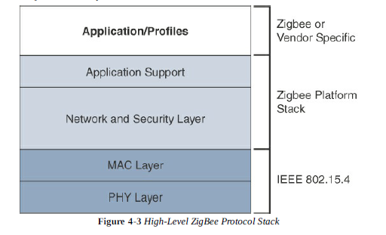
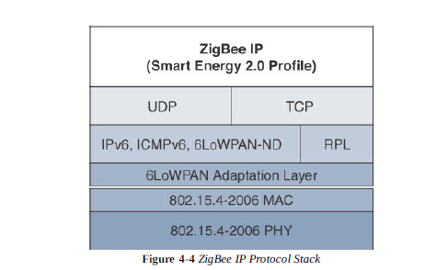
ZigBee:
ZigBee solutions are aimed for smart objects and sensors having low bandwidth and low power needs.
Implementation areas include automation of commercial, retail, home applications, smart energy

Slide 64
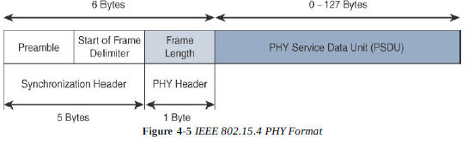
Physical Layer
2.4 GHz, 16 channels, with a data rate of 250 kbps-> world wide
915 MHz, 10 channels, with a data rate of 40 kbps-> north and south America
868 MHz, 1 channel, with a data rate of 20 kbps-> Europe, middle east, Africa
Physical communication improvements includes the following:
OQPSK PHY-> uses 4 unique bit values that are phase changes
BPSK PHY-> specifies 2 unique phase shifts as its data encoding scheme
ASK PHY-> offers increased range, throughput, data rate, and signal integrity

Slide 65
MAC Layer
MAC layer defines how devices in the same area will share the frequencies allocated.
The scheduling and routing data frames are also co-ordinated.
Performs the following tasks:
Network beaconing for devices acting as coordinators
PAN association and disassociation by a device
Device security
Reliable link communication between two peer MAC entities
4 types of MAC frames:
Data frame-> handles all transfers of data
Beacon frame-> used in the transmission of beacons from PAN controller
Acknowledgement frame-> confirms successful reception of frame
MAC command frame-> responsible for control communication between devices

Slide 66
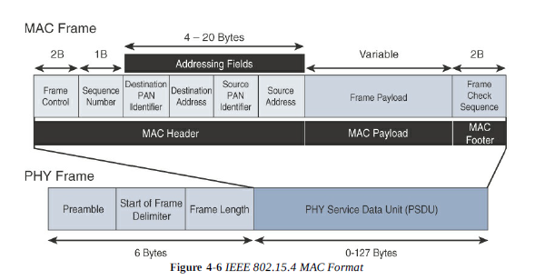

Slide 67
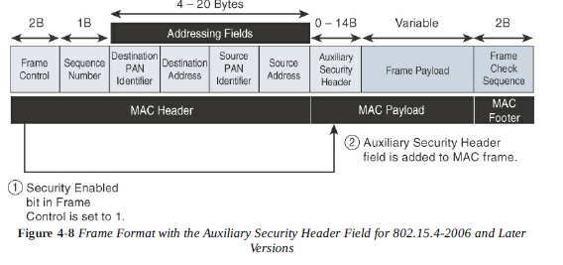
Uses AES symmetric key cryptography

Slide 68
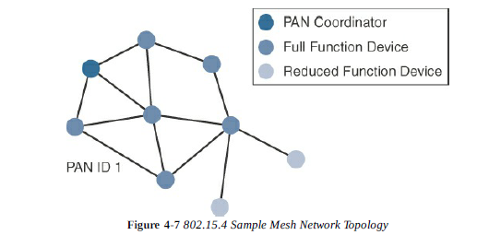
Topology

Slide 69
Competitive technologies:
DASH7-> radio technology based on IEEE802.15.4, difference in Phy and MAC layer, used for US military applications
Offers low power consumption, compact protocol stack, range up to 1 mile, and AES encryption
Frequency range used: 433MHz, 868MHz, 915MHz
Data rate:166.667kbps and maximum payload of 256 bytes

Slide 70
IEEE 802.15.4e and IEEE 802.15.4g
IEEE 802.14.5e is the amendments for expansion of MAC layer features and application domains such as factory, process automation, and smart grid.
IEEE 802.15.4g is specifically designed for smart grid, smart utility communication. It also optimizes large outdoor wireless mesh networks for FAN. Modifications are done both in PHY and MAC layer.
Implementation areas:
Public lighting, microgrids, renewable energy, smart parking meter, electrical vehicle
Industry Alliances for some common IEEE standards
Commercial name | Industry organization | Standards body
Wi-Fi | Wi-Fi Alliance | IEEE 802.11 wireless LAN
WiMAX | Wi-MAX Forum | IEEE 802.16 Wireless MAN
Wi-SUN | Wi-SUN Alliance | IEEE 802.15.4g Wireless SUN

Slide 71
PHY Layer mechanisms:
Multi-rate and multi-regional frequency shift keying(MR-FSK)-> offers good transmit power efficiency due to the constant envelope of transmit signal
Multi-rate and multi-regional orthogonal frequency division multiplexing(MR-OFDM)-> provides higher data rate but may be too complex for low-cost and low-power devices
Multi-rate and multi-regional offset quadrature phase shift keying(MR-O-QPSK)->makes multimode systems more cost-effective and easier to design.
MAC Layer mechanisms:
Time-slotted channel hopping(TSCH)->works to guarantee media access and channel diversity. It divides time in to “time slots” which offer guaranteed bandwidth and predictable latency. A number of time slots are defined as “slot frame” which is regularly repeated to provide “guaranteed access”. TSCH adds robustness in noisy environments and smoother coexistence with other wireless technologies (industrial use cases)
Information elements(IE)->allows exchange of information at the MAC layers, either as header or payload. It allows frames to carry additional meta data to support MAC layer services.
Enhanced beacons(EB)->allows the construction of application-specific beacon content. It includes relevant IEs in the EB frames.

Slide 72
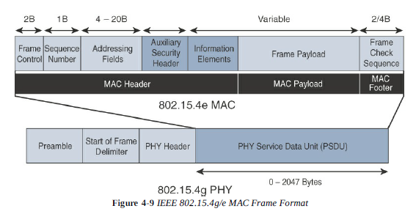
Enhanced beacon requests(EBRs)->allows the sender to selectively specify the request of information. Beacon responses are then limited to what was requested in EBR.
Enhanced acknowledgement->allows for the integration of a frame counter for the frame being acknowledged. It helps to protect against certain attacks that occur when acknowledgement frames are spoofed.

Slide 73
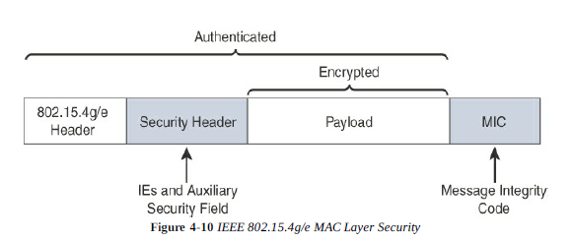
Topology-> mostly mesh topology (best for industry and smart city deployments) is used. Used to implement in urban and rural areas, expanding the distance between nodes that can relay the traffic of other nodes.
Security->AES encryption is used, with 128 bit key. Additional secure enhanced beacon and secure acknowledgement is added. MIC and KMP are the key features of IEEE 802.15.4g/e security.
Competitive technologies-> DASH7, and upper layer protocols of 802.15.4

Slide 74
IEEE 1901.2a
It is a wired technology and standard of narrow band power line communication (NB-PLC)
It leverages a narrowband spectrum for low power, long range, and resistance to interference over the same wires that carry electric power.
Use case:
Smart metering
Distribution automation
Public lighting
Electric vehicle charging stations
Microgrids
Renewable energy

Slide 75
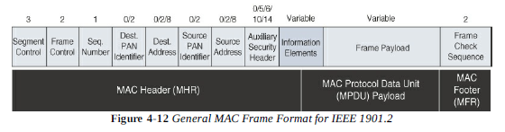
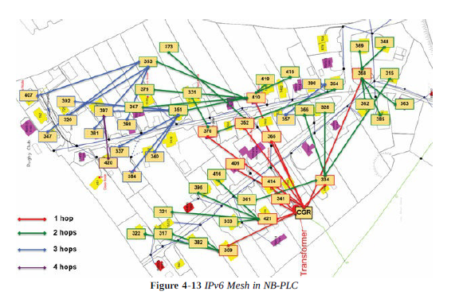
MAC layer and Topology

Slide 76
Security
If data encryption is required, it should be set in all MAC frames carrying segments of an encrypted frame
On the receiver side the data encryption is done after packet reassembly
When the security is enabled, the MAC payload is composed of the ciphered payload and the message integrity code authentication. If the payload is segmented, the MIC is present in the last segment only.
Competitive Technologies: PRIME, G3-PLC

Slide 77
IEEE 802.11ah(Wi-Fi HaLow->Wi-SUN)
It is the most successfully deployed wireless technology and standard key IoT access technology.
Use cases:
Sensers and meters covering a smart grid
Backhaul aggregation of industrial sensors and meter data->subnetworks
Extended range of Wi-Fi-> hotspot
Physical Layer:
100kbps data rate, transmission range is 0.62mile
Various countries and regions are having different bands for IEEE 802.11h:-902-928MHz-north America & Asia pacific regions, 314-316 MHZ, 430-434MHz, 470-510 MHz, 779-787 MHz for China

Slide 78
MAC Layer
802.11ah MAC layer is optimized to support the new sub-GHz Wi-Fi PHY while providing low power consumption and the ability to support a large number of end points.
Enhancement features:
Number of devices: scaled up to 8192/access point
MAC header: allow more efficient communication
Null data packet(NDP)support: contains several control and management frames. Relevant information is stored in the PHY header and additional overhead is stored in the MAC header.
Grouping and sectorization
Restricted access window(RAW): is a control algorithm that provides simultaneous transmissions when many devices are present
Target wake time(TWT): reduces energy consumption by permitting an access point to define time when a device can access the network.
Speed frame exchange: Enables an AP and endpoint to exchange frames during the reserved transmit opportunity.

Slide 79
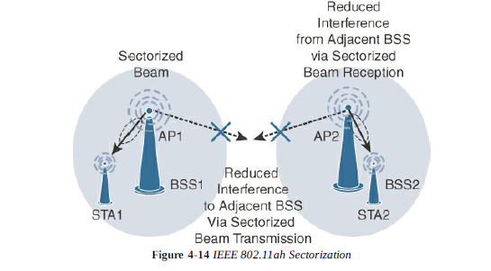
Topology, Security, Competitive Technologies:
Star and mesh topology
Same security protocols as 802.15.4e and 1901.2a
DASH7, PRIME, G3-PLC

Slide 80
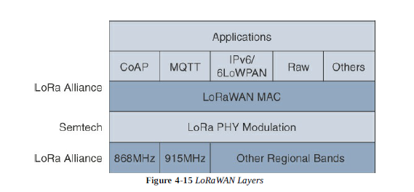
LoRaWAN
Unlicensed low-powered wide area(LPWA) technology is known as LoRaWAN
Physical Layer->
Semtech LoRa modulation is based on Chirp spread spectrum modulation, which trades a lower data rate for receiver sensitivity to increase the communication distance.
It allows demodulation, offers robustness to noise and interference. This enables LoRa devices to receive multiple channel in parallel.
It specifies frequency bands according to regional
specifications.
The data rate varies depending on the frequency
bands and adaptive data rate(ADR).
ADR is an algorithm that manages the data rate
and radio signal for each end point.
End points close to the gateways transmit with
highest data rate.

Slide 81
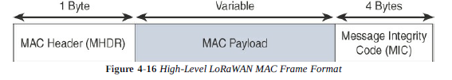
MAC Layer
It classifies the LoRaWAN end points to optimize their battery life and ensure downstream communications.
3 types of LoRaWAN devices:
Class A:Default implementation, optimized for battery powered nodes, allows bi-directional communication.
Class B:designated as “experimental”.
Class C:adapted for powered nodes. It continuous listens when not transmitting by keeping the receive window open.

Slide 82
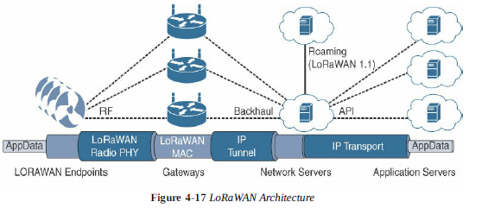
LoRaWAN end points are uniquely addressable using the following methods:
An end point can have a global end device ID called DevEUI
An end point can have a global application ID called APPEUI
An end point is known by its 32-bit(7+25) DevAddr(NwkID+NwkAddr)
Topology:
LoRaWAN topologies are termed as “star of stars” topology.

Slide 83
LoRaWAN is having two versions-(1) simple, (2) version-2 which supports a features known as geolocation.
Geolocation share an accurate time source and then adding a high-resolution timestamp to each received LoRa packet. The end points’ geolocation can be determined by using time differential of arrival (TDoA) algorithms.
LoRaWAN network manages the data rate and radio frequency of each end point through ADR algorithm, which is the key point for network scalability, performance, and battery life of the end points.
Security:
LoRaWAN endpoints applies 2-layers of security, for communication protection and data privacy.
The 1st layer is called “network security”, applied in MAC layer, guarantees the authentication of the end points by LoRaWAN network servers. It performs AES encryption to protect LoRaWAN packets. Each end point implements a network session key (NwkSKey) which ensures data integrity.
The 2nd layer is called “application session key”(AppSKey) which performs encryption and decryption functions between the endpoint and its application server. The endpoints must receive AES-128 application key(AppKey) from the application provider.

Slide 84
For production deployment LoRaWAN gateways need to implement IPSec, and VPN technologies to provide security to both LoRaWAN network and the backhaul links
LoRaWAN end points attached to a LoRaWAN network must be registered using one of the following join mechanisms:
Activation by personalization(ABP): The DevAddr, NwkSKey, AppSKey are preconfigured and stored in the end device. This information is registered in the LoRaWAN network server.
Over-the-air activation(OTAA): The The DevEUI, AppEUI, and AppKey are used to join an end point dynamically to a LoRaWAN network by sending join request message and after getting join accept message, every time a session context is renewed. The AppKey is used to derive the NwkSkey and AppSKey after the end point has joined the LoRaWAN network successfully.

Slide 85
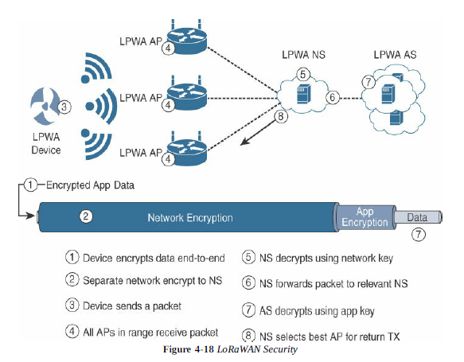

Slide 86
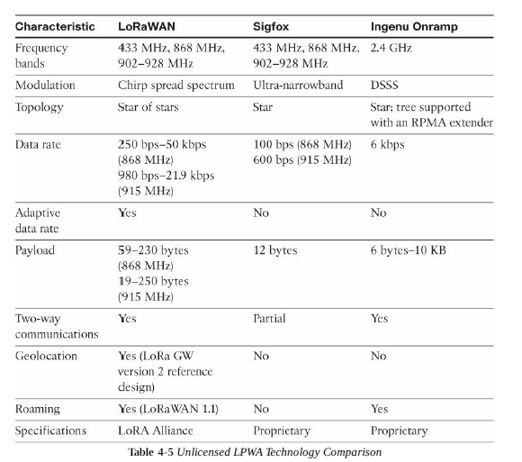
Competitive Technologies:

Slide 87
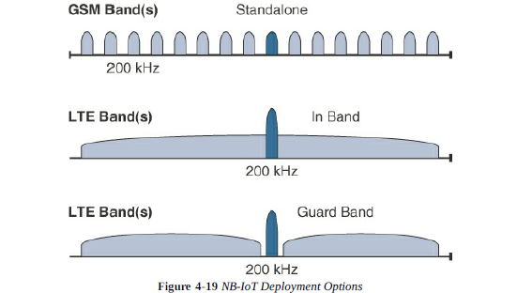
NB-IoT and other LTE Variations
LTE Cat 0: Max data rate of 1 Mbps, bandwidth 20 MHz, power saving mode, half-duplex mode.
LTE-M: Max data rate 200kbps, bandwidth 1.4MHz, enhanced discontinuous reception (eDRX), half-duplex mode
NB-IoT:It addresses massive number of low-throughput devices, low device power consumption, improved indoor coverage, and optimized network architecture.
3 mode of operations are applicable to NB-IoT:

Slide 88
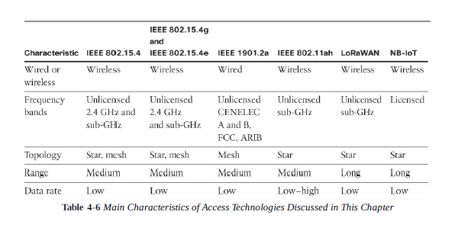
NB-IoT operates in half-duplex frequency division duplexing (FDD) mode with maximum data rate uplink of 60 kbps and downlink of 30 kbps.
NB-IoT is the future of LPWA technologies with evolution of eSIMs.
Summary:

